Slide 1
Deadlock
Definition of deadlock
Condition for its occurrence
Solutions for avoiding and breaking deadlock
  Deadlock Prevention
  Deadlock Avoidance
  Deadlock Detection
  Recovery from Deadlock

Slide 2
Resources
Examples of computer resources
  printers
  tape drives
  tables
Processes need access to resources in reasonable order
Suppose a process holds resource A and requests resource B
  at the same time another process holds B and requests A
  both are blocked and remain so

Slide 3
Resources (1)
Deadlocks occur when …
  processes are granted exclusive access to devices
  we refer to these devices generally as resources
Preemptable resources
  can be taken away from a process with no ill effects
  e.g. CPU, Memory
Nonpreemptable resources
  will cause the process to fail if taken away
  e.g. Disk space, plotter, chunk of virtual address space
    Mutual exclusion – the right to enter a critical section

Slide 4
Resources (2)
Sequence of events required to use a resource
  request the resource
  use the resource
  release the resource
Must wait if request is denied
  requesting process may be blocked
  may fail with error code

Slide 5
Introduction to Deadlocks
Formal Definition:
  A set of processes is deadlocked if each process in the set is waiting for an event that only another process in the set can cause.
Example
  semaphores A and B, initialized to 1
        P₀ P₁
        wait(A); wait(B)
        wait(B); wait(A)

Slide 6
Starvation vs Deadlock
Starvation vs. Deadlock
  Starvation: thread waits indefinitely
    Example, low-priority thread waiting for resources constantly in use by high-priority threads
  Deadlock: circular waiting for resources
    Thread A owns Res 1 and is waiting for Res 2
    Thread B owns Res 2 and is waiting for Res 1
  Deadlock ⇒ Starvation but not vice versa
    Starvation can end (but doesn’t have to)
    Deadlock can’t end without external intervention
Thread
A
Wait
For
Owned
By
Res 1
Res 2
Owned
By
Wait
For
Thread
B

Slide 7
Necessary Conditions for Deadlock
Mutual exclusion condition
  each resource assigned to 1 process or is available
Hold and wait condition
  process holding resources can request additional
No preemption condition
  previously granted resources cannot forcibly taken away
Circular wait condition
  must be a circular chain of 2 or more processes
  each is waiting for resource held by next member of the chain

Slide 8



Bridge Crossing Example
Honk!
Each segment of road can be viewed as a resource
  Car must own the segment under them
  Must acquire segment that they are moving into
For bridge: must acquire both halves
  Traffic only in one direction at a time
  Problem occurs when two cars in opposite directions on bridge: each acquires one segment and needs next
If a deadlock occurs, it can be resolved if one car backs up (preempt resources and rollback)
  Several cars may have to be backed up
Starvation is possible
  East-going traffic really fast ⇒ no one goes west

Slide 9
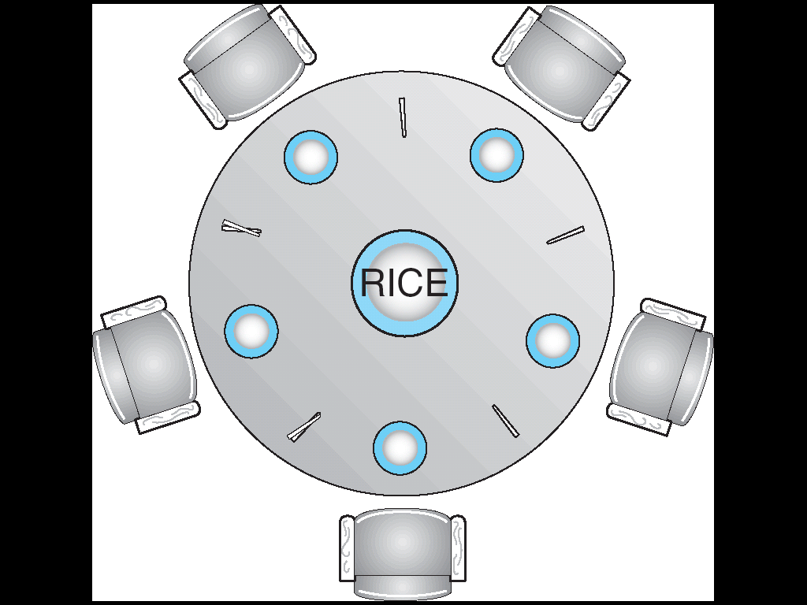
Dining Philosophers Problem
Five chopsticks/Five Philosophers (really cheap restaurant)
What if all grab at same time?
  Deadlock!
How to fix deadlock?
  Make one of them give up a chopstick (Hah!)
  Eventually everyone will get chance to eat
How to prevent deadlock?
  Never let Philosophers take last chopstick if no hungry Philosophers has two chopsticks afterwards
  Request both chopsticks at the same time

Slide 10
Resource-Allocation Graph
Process
Resource Type with 4 instances
P_{i} requests instance of R_{j}
P_{i} is holding an instance of R_{j}
P_{i}
R_{j}
P_{i}
R_{j}

Slide 11

Example of a Resource Allocation Graph

Slide 12

Resource Allocation Graph With A Deadlock

Slide 13

Resource Allocation Graph With A Cycle But No Deadlock

Slide 14
Basic Facts
If graph contains no cycles ⇒ no deadlock.
If graph contains a cycle ⇒
  if only one instance per resource type, then deadlock.
  if several instances per resource type, possibility of deadlock.

Slide 15
Strategies for dealing with Deadlocks
just ignore the problem altogether
prevention
  negating one of the four necessary conditions
dynamic avoidance
  careful resource allocation
detection and recovery

Slide 16
The Ostrich Algorithm
Pretend there is no problem
Reasonable if
  deadlocks occur very rarely
  cost of prevention is high
UNIX and Windows takes this approach
It is a trade off between
  convenience
  correctness

Slide 17
Deadlock Prevention
Attacking the Mutual Exclusion Condition
Some devices (such as printer) can be spooled
  only the printer daemon uses printer resource
  thus deadlock for printer eliminated
Not all devices can be spooled

Slide 18
Attacking the Hold and Wait Condition
Request all resources before starting
  a process never has to wait for what it needs
Request resources only when the process has none.
  process must give up all resources
  then request all immediately needed
Examples
  If need 2 chopsticks, request both at the same time
  How the phone company avoids deadlock
  Technique used in Ethernet/some multiprocessor nets
    Everyone speaks at once. On collision, back off and retry
Problems
  may not know required resources at start of run
  also ties up resources other processes could be using
  starvation

Slide 19
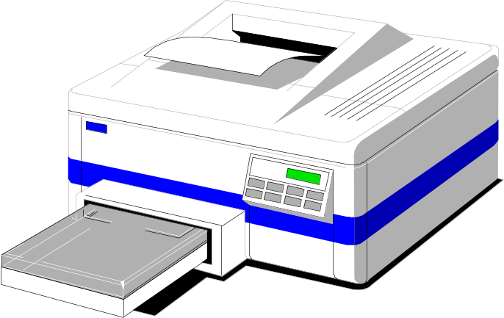
Attacking the No Preemption Condition
Applied to resources whose state can be easily saved and restored later
  Ex: CPU registers and memory space
This is not a viable option for most resources
Consider a process given the printer
  halfway through its job
  now forcibly take away printer
  !!??

Slide 20
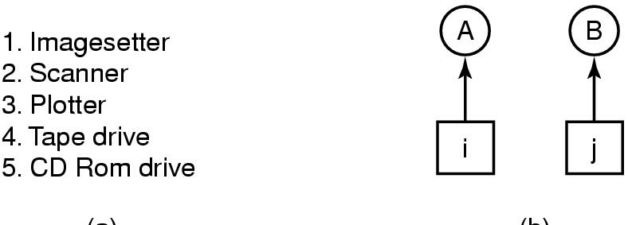
Attacking the Circular Wait Condition (1)
(a) (b)
Normally ordered resources
A resource graph

Slide 21
Deadlock Example
/* thread one runs in this function */
void *do_work_one(void *param)
{
pthread_mutex_lock(&first_mutex);
pthread_mutex_lock(&second_mutex);
/** * Do some work */
pthread_mutex_unlock(&second_mutex);
pthread_mutex_unlock(&first_mutex);
pthread_exit(0);
}
/* thread two runs in this function */
void *do_work_two(void *param)
{
pthread_mutex_lock(&second_mutex);
pthread_mutex_lock(&first_mutex);
/** * Do some work */
pthread_mutex_unlock(&first_mutex);
pthread_mutex_unlock(&second_mutex);
pthread_exit(0);
}

Slide 22
Deadlock Example with Lock Ordering
void transaction(Account from, Account to, double amount)
{
mutex lock1, lock2;
lock1 = get_lock(from);
lock2 = get_lock(to);
acquire(lock1);
acquire(lock2);
withdraw(from, amount);
deposit(to, amount);
release(lock2);
release(lock1);
}
Transactions 1 and 2 execute concurrently. Transaction 1 transfers $25 from account A to account B, and Transaction 2 transfers $50 from account B to account A

Slide 23
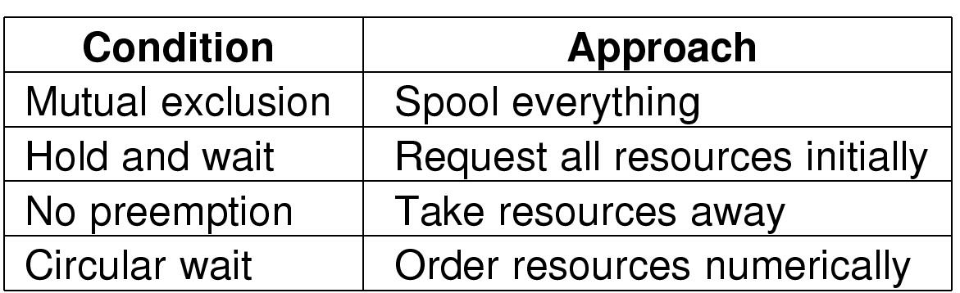
Summary of approaches to deadlock prevention
Problems:
  low resource utilization
  reduced system throughput

Slide 24
Deadlock Avoidance
Requires that the system has some additional a priori information
available.
Simplest and most useful model requires that each process declare the maximum number of resources of each type that it may need.
The deadlock-avoidance algorithm dynamically examines the resource-allocation state to ensure that there can never be a circular-wait condition.
Resource-allocation state is defined by the number of available and allocated resources, and the maximum demands of the processes.

Slide 25
Safe State
When a process requests an available resource, system must decide if immediate allocation leaves the system in a safe state.
System is in safe state if there exists a safe sequence of all processes.
Sequence <P₁, P₂, …, P_{n}> is safe if for each P_{i}, the resources that Pi can still request can be satisfied by currently available resources + resources held by all the P_{j}, with j<i.
  If P_{i} resource needs are not immediately available, then P_{i} can wait until all P_{j} have finished.
  When P_{j} is finished, P_{i} can obtain needed resources, execute, return allocated resources, and terminate.
  When P_{i} terminates, P_{i+1} can obtain its needed resources, and so on.

Slide 26
Basic Facts
If a system is in safe state ⇒ no deadlocks.
If a system is in unsafe state ⇒ possibility of deadlock.
Avoidance ⇒ ensure that a system will never enter an unsafe state.

Slide 27

Safe, Unsafe , Deadlock State

Slide 28
Resource-Allocation Graph Algorithm
Claim edge P_{i} → R_{j} indicated that process P_{i} may request resource R_{j}; represented by a dashed line.
Claim edge converts to request edge when a process requests a resource.
When a resource is released by a process, assignment edge reconverts to a claim edge.
Resources must be claimed a priori in the system.

Slide 29

Resource-Allocation Graph For Deadlock Avoidance

Slide 30

Unsafe State In Resource-Allocation Graph

Slide 31
Banker’s Algorithm
Multiple instances.
Each process must a priori claim maximum use.
When a process requests a resource it may have to wait.
When a process gets all its resources it must return them in a finite amount of time.

Slide 32
Data Structures for the Banker’s Algorithm
Let n = number of processes, and m = number of resources types.
Available: Vector of length m. If available [j] = k, there are k instances of resource type R_{j} available.
Max: n x m matrix. If Max [i,j] = k, then process P_{i} may request at most k instances of resource type R_{j}.
Allocation: n x m matrix. If Allocation[i,j] = k then P_{i} is currently allocated k instances of R_{j.}
Need: n x m matrix. If Need[i,j] = k, then P_{i} may need k more instances of R_{j} to complete its task.
    Need [i,j] = Max[i,j] – Allocation [i,j].

Slide 33
Safety Algorithm
1. Let Work and Finish be vectors of length m and n, respectively. Initialize:
      Work = Available
      Finish [i] = false for i = 0, 1, …, n- 1
2. Find an i such that both:
  (a) Finish [i] = false
  (b) Need_{i} ≤ Work
  If no such i exists, go to step 4
3. Work = Work + Allocation_{i}
Finish[i] = true
go to step 2
4. If Finish [i] == true for all i, then the system is in a safe state

Slide 34
Resource-Request Algorithm for Process P_{i}
Request_{i} = request vector for process P_{i}. If Request_{i} [j] = k then process P_{i} wants k instances of resource type R_{j}
  1. If Request_{i} ≤ Need_{i} go to step 2. Otherwise, raise error condition, since process has exceeded its maximum claim
  2. If Request_{i} ≤ Available, go to step 3. Otherwise P_{i} must wait, since resources are not available
  3. Pretend to allocate requested resources to P_{i} by modifying the state as follows:
      Available = Available – Request_{i};
      Allocation_{i} = Allocation_{i} + Request_{i};
      Need_{i} = Need_{i} – Request_{i};
    If safe ⇒ the resources are allocated to P_{i}
    If unsafe ⇒ P_{i} must wait, and the old resource-allocation state is restored

Slide 35
Example of Banker’s Algorithm
5 processes P₀ through P₄; 3 resource types A
(10 instances), B (5instances), and C (7 instances).
Snapshot at time T₀:
Allocation Max Available
A B C A B C A B C
P₀ 0 1 0 7 5 3 3 3 2
P₁ 2 0 0 3 2 2
P₂ 3 0 2 9 0 2
P₃ 2 1 1 2 2 2
P₄ 0 0 2 4 3 3

Slide 36
Example (Cont.)
The content of the matrix. Need is defined to be Max – Allocation.
Need
A B C
P₀ 7 4 3
P₁ 1 2 2
P₂ 6 0 0
P₃ 0 1 1
P₄ 4 3 1
The system is in a safe state since the sequence
< P₁, P₃, P₄, P₂, P₀> satisfies safety criteria.

Slide 37
Example P₁ Request (1,0,2) (Cont.)
Check that Request ≤ Available (that is, (1,0,2) ≤ (3,3,2) ⇒ true.
Allocation Need Available
A B C A B C A B C
P₀ 0 1 0 7 4 3 2 3 0
P₁ 3 0 2 0 2 0
P₂ 3 0 1 6 0 0
P₃ 2 1 1 0 1 1
P₄ 0 0 2 4 3 1
Executing safety algorithm shows that sequence <P₁, P₃, P₄, P₀, P₂> satisfies safety requirement.
Can request for (3,3,0) by P₄ be granted?
Can request for (0,2,0) by P₀ be granted?

Slide 38
Deadlock Detection
Allow system to enter deadlock state
Detection algorithm
Recovery scheme

Slide 39
Single Instance of Each Resource Type
Maintain wait-for graph
  Nodes are processes.
  P_{i} → P_{j} if P_{i} is waiting for P_{j}.
Periodically invoke an algorithm that searches for a cycle in the graph.
An algorithm to detect a cycle in a graph requires an order of n² operations, where n is the number of vertices in the graph.

Slide 40

Resource-Allocation Graph and Wait-for Graph
Resource-Allocation Graph
Corresponding wait-for graph

Slide 41
Several Instances of a Resource Type
Available: A vector of length m indicates the number of available resources of each type.
Allocation: An n x m matrix defines the number of resources of each type currently allocated to each process.
Request: An n x m matrix indicates the current request of each process. If Request [i_{j}] = k, then process P_{i} is requesting k more instances of resource type. R_{j}.

Slide 42
Detection Algorithm
1. Let Work and Finish be vectors of length m and n, respectively Initialize:
  (a) Work = Available
  (b) For i = 1,2, …, n, if Allocation_{i} ≠ 0, then
  Finish[i] = false;otherwise, Finish[i] = true.
2. Find an index i such that both:
  (a) Finish[i] == false
  (b) Request_{i} ≤ Work
  If no such i exists, go to step 4.

Slide 43
Detection Algorithm (Cont.)
3. Work = Work + Allocation_{i}
Finish[i] = true
go to step 2.
4. If Finish[i] == false, for some i, 1 ≤ i ≤ n, then the system is in deadlock state. Moreover, if Finish[i] == false, then P_{i} is deadlocked.
Algorithm requires an order of O(m x n²⁾ operations to detect whether the system is in deadlocked state.

Slide 44
Example of Detection Algorithm
Five processes P₀ through P₄; three resource types
A (7 instances), B (2 instances), and C (6 instances).
Snapshot at time T₀:
Allocation Request Available
A B C A B C A B C
P₀ 0 1 0 0 0 0 0 0 0
P₁ 2 0 0 2 0 2
P₂ 3 0 3 0 0 0
P₃ 2 1 1 1 0 0
P₄ 0 0 2 0 0 2
Sequence <P₀, P₂, P₃, P₁, P₄> will result in Finish[i] = true for all i.

Slide 45
Example (Cont.)
P₂ requests an additional instance of type C.
Request
A B C
P₀ 0 0 0
P₁ 2 0 1
P₂ 0 0 1
P₃ 1 0 0
P₄ 0 0 2
State of system?
  Can reclaim resources held by process P₀, but insufficient resources to fulfill other processes; requests.
  Deadlock exists, consisting of processes P₁, P₂, P₃, and P₄.

Slide 46
Detection-Algorithm Usage
When, and how often, to invoke depends on:
  How often a deadlock is likely to occur?
  How many processes will need to be rolled back?
    one for each disjoint cycle
If detection algorithm is invoked arbitrarily, there may be many cycles in the resource graph and so we would not be able to tell which of the many deadlocked processes “caused” the deadlock.

Slide 47
Recovery from Deadlock: Process Termination
Abort all deadlocked processes.
Abort one process at a time until the deadlock cycle is eliminated.
In which order should we choose to abort?
  Priority of the process.
  How long process has computed, and how much longer to completion.
  Resources the process has used.
  Resources process needs to complete.
  How many processes will need to be terminated.
  Is process interactive or batch?

Slide 48
Recovery from Deadlock: Resource Preemption
Preempt resources without killing off thread
  Take away resources from thread temporarily
  Doesn’t always fit with semantics of computation
Rollback – return to some safe state, restart process for that state.
  For bridge example, make one car roll backwards (may require others behind him)
  Common technique in databases (transactions)
  Of course, if you restart in exactly the same way, may reenter deadlock once again
Starvation – same process may always be picked as victim, include number of rollback in cost factor.

